Slide 1
Image Thresholding
Image Segmentation

Slide 2
Image Thresholding
An image histogram can be used to threshold the image to convert it into a binary image.
If the image intensities are well separated into two defined objects, the histogram is well suited to define the threshold of the image.
The histogram will be bi-modal and the pixel intensities can be separated into two well-defined groups.

Slide 3
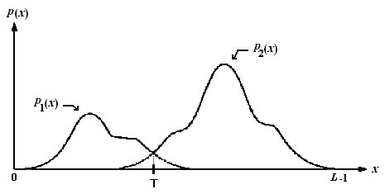
Image Thresholding
Image Source: Optimal Threshold Computing in Automatic Image Thresholding using Adaptive Particle Swarm Optimization

Slide 4
Image Thresholding– Binary Thresholding
If T is the obtained threshold, then the image can be binarized using the following relation:
For all pixel p in image I:
If p >= T:
p = 0
Else
p = 1

Slide 5
Example

Slide 6
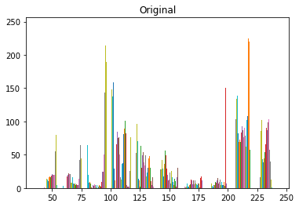
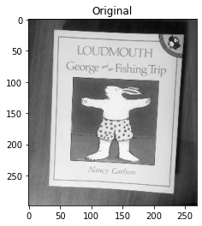
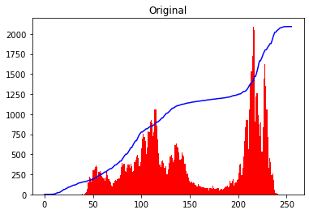

Slide 7
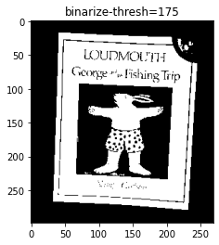
Thresh=175
if(m_img[i,j]>=thresh):
new_im[i,j]=1
else:
new_im[i,j]=0

Slide 8
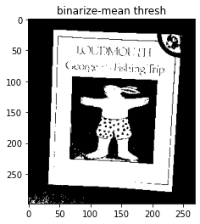
Mean Thresholding
Thresh= mean= 155

Slide 9
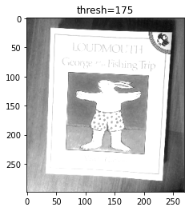
Thresh=175
if(m_img[i,j]>thresh):
new_im[i,j]=thresh
else:
new_im[i,j]=m_img[i,j]

Slide 10
Image Thresholding
Import cv2 as cv
Import imageio as io
Im=io.imread(‘cat_hat.jpg’)
thresh=np.mean(Im) # mean threshold
r,c=m_img.shape
i=0
j=0
new_im=np.zeros((r,c),dtype=np.uint8)
for i in range(r):
for j in range(c):
if(m_img[i,j]>=thresh):
new_im[i,j]=1
else:
new_im[i,j]=0
plt.imshow(new_im,cmap="gray")
plt.show()
plt.close()

Slide 11
More Examples

Slide 12
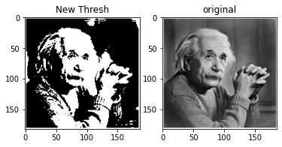
Mean Thresholding

Slide 13
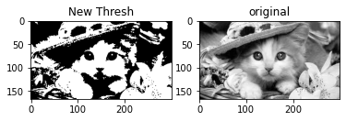

Slide 14
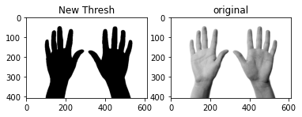

Slide 15
Thresholding -- OpenCV
Cv2 library in Python for Thresholding
Cv2.threshold
Ret,dest=cv2.threshold(im,thresh,max_value,cv2.ThresholdType)

Slide 16
Thresholding -- OpenCV
Cv2.threshold
Ret,dest=cv2.threshold(im,thresh,max_value,cv2.ThresholdType)
Ret,thresh=cv2.threshold(im,120,256,cv2.Threshold_Binary)

Slide 17
Thresholding -- OpenCV
Cv2.threshold
Ret,dest=cv2.threshold(im,thresh,max_value,cv2.ThresholdType)
cv2.THRESH_BINARY
cv2.THRESH_BINARY_INV
cv2.THRESH_TRUNC
cv2.THRESH_TOZERO
cv2.THRESH_TOZERO_INV

Slide 18

Thresholding -- OpenCV
Cv2.threshold
Ret,dest=cv2.threshold(im,thresh,max_value,cv2.ThresholdType)
cv2.THRESH_BINARY

Slide 19

Thresholding -- OpenCV
Cv2.threshold
Ret,dest=cv2.threshold(im,thresh,max_value,cv2.ThresholdType)
cv2.THRESH_BINARY_INV

Slide 20

Thresholding -- OpenCV
Cv2.threshold
Ret,dest=cv2.threshold(im,thresh,max_value,cv2.ThresholdType
cv2.THRESH_TRUNC

Slide 21

Thresholding -- OpenCV
Cv2.threshold
Ret,dest=cv2.threshold(im,thresh,max_value,cv2.ThresholdType
cv2.THRESH_TOZERO

Slide 22

Image Thresholding
Cv2.threshold
Ret,dest=cv2.threshold(im,thresh,max_value,cv2.ThresholdType
cv2.THRESH_TOZERO_INV

Slide 23
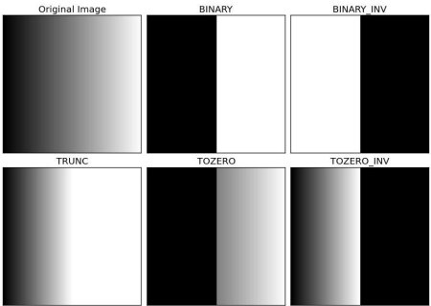
Thresholding -- OpenCV
Cv2 library in Python for Thresholding
Cv2.threshold

Slide 24
Thresholding -- OpenCV
Cv2 library in Python for Thresholding
Cv2.threshold
Ret,dest=cv.threshold(im1,190,255,cv.THRESH_BINARY)

Slide 25
Thresholding
Cv2 library in Python for Thresholding
Cv2.threshold
Ret,dest=cv.threshold(im1,190,255,cv.THRESH_BINARY_INV)

Slide 26
Thresholding
Cv2 library in Python for Thresholding
Cv2.threshold
Ret,dest=cv.threshold(im1,190,255,cv.THRESH_TRUNC)

Slide 27
Thresholding
Cv2 library in Python for Thresholding
Cv2.threshold
Ret,dest=cv.threshold(im1,190,255,cv.THRESH_TOZERO)

Slide 28
Thresholding
Cv2.threshold
Import cv2 as cv
Thresh=190
Ret,dest=cv.threshold(im,thresh,255,cv.THRESH_TOZERO_INV)
plt.imshow(dest,cmap="gray")
plt.show()
plt.close()

Slide 29
Thresholding: [Otsu Method]
The thresholds that we used so far are arbitrary chosen threshold values , which is not a good choice.
Otsu method determines the threshold value of the image automatically.
We need to pass an extra argument to cv.threshold function
Ret, dest=cv2.threshold(im,thresh,max_value,cv2.ThresholdType+cv2.Thresh_Otsu)
Ret is the optimum threshold value calculated using Otsu method.

Slide 30
Image Thresholding + OTSU Method
Python:
Import cv2 as cv
Import imageio as io
Io.imread(‘original.png’)
Ret,dest=cv.threshold(im,0,255,cv.THRESH_BINARY+cv.THRESH_OTSU)
plt.imshow(dest,cmap="gray")
plt.show()
plt.close()

Slide 31
Thresholding: [Otsu Method ---- Continued ]
Otsu Method maximized the between class variance……
Otsu method iterate through all possible threshold values
And find the spread of pixels on each side of the threshold i.e. for foreground and for background.
Select that particular intensity as threshold value having minimum foreground and background spread i.e minimize the within class variance.

Slide 32
Thresholding
The techniques that we studied so far are Global Thresholding i.e. it selects only one value for the whole image.
Problem: What if different section of the image has variation in lighting?
Global Thresholding is NOT appropriate solution
Adaptive thresholding is a better solution in that case. The algorithm determines the threshold of a pixel based On the surrounding region.

Slide 33
Local Thresholding
Different options are available for adaptive thresholding
Grid of Cells
Statistically measurement of intensity values of the
Local neighbourhood for each pixel.
OpenCV ---→ CV2.adaptivehreshold

Slide 34
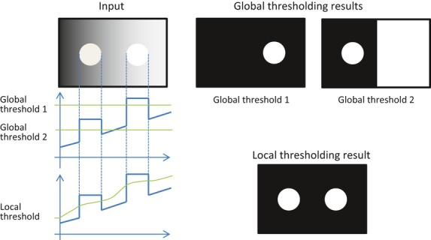
Local Thresholding
local threshold is determined at each pixel
by the local average around the pixel.
Image Courtesy: https://www.researchgate.net/figure/Binarization-by-global-thresholding-and-local-thresholding-For-this-input-image-no_fig3_236125496

Slide 35
Adaptive Thresholding
Dest = cv.adaptiveThreshold (src, maxValue, adaptiveMethod, thresholdType, blockSize, C)

Slide 36
Adaptive Thresholding
Adaptive Method - It decides how thresholding value is calculated
cv2.ADAPTIVE_THRESH_MEAN_C : threshold value is the mean of neighbourhood area.
cv2.ADAPTIVE_THRESH_GAUSSIAN_C : threshold value is the weighted sum of neighbourhood values where
weights are a gaussian window.

Slide 37
Adaptive Thresholding
import cv2 as cv
import numpy as np
from matplotlib import pyplot as plt
img = cv.imread('original.png',0)
ret,im1 = cv.threshold(img,180,255,cv.THRESH_BINARY)
im2 = cv.adaptiveThreshold(img,255,cv.ADAPTIVE_THRESH_MEAN_C, cv.THRESH_BINARY,11,2)
plt.imshow(im1,cmap="gray")
plt.show()
plt.close()
plt.imshow(im2,cmap="gray")
plt.show()
plt.close()

Slide 38
Application
Image segmentation

